Slide 1

Object Oriented Programming with C#
CS107.3
Lecture #06
Pramudya Thilakaratne pramudya.h@nsbm.ac.lk
Lecturer
Faculty of Computing
NSBM Green University

Slide 2
Welcome to Lecture 06!
Take your notebooks and prepare
You can ask questions via either chat message or over the mic.
When you are not using the mic please mute it.

Slide 3

From Last Week
OOP Programming Concepts
Encapsulation

Slide 4
Encapsulation Exercise 01
Create a console application with an encapsulated class.
Inside the class create a private variable to store the user’s age.
Create getters and setters set user’s age and check whether the user is eligible for voting or not.
From main class program should take user’s age as an input.

Slide 5
Encapsulation Exercise 02
Read the following instructions and create the console application program
Create a class called EncapData.cs and create two private variables to store radius value and pi value.
Inside the main class you have to get the radius value from the user and pass it to EncapData.cs Class.
Inside EncapData.cs class create getters and setters to find the Area of the circle and to find the circumference of the circle.
Return the answers from the EncapData.cs Class
Display the answers inside Main class (program.cs).

Slide 6
Encapsulation Exercise 03
Is it possible to access protected variables from other classes which are not derived from the class which has the variable? Explain your answer.

Slide 7
Inheritance
One of the most important concepts in object-oriented programming.
Inheritance allows us to define a class in terms of another class, which makes it easier to create and maintain an application.
This also provides an opportunity to reuse the code functionality and speed up implementation time.

Slide 8
Inheritance Cont.
When creating a class, instead of writing completely new data members and member functions, the programmer can designate that the new class should inherit the members of an existing class.
The existing class is called the base class (Parent), and the new class is referred to as the derived class (Child).

Slide 9
Initialization of Base class and derived class
Any class can be a base class.
There is no dedicated rule for creating base class.
When creating a child class, you can simply inherit base class followed by colon( : ) symbol.

Slide 10
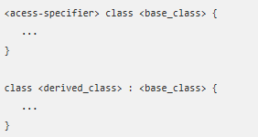
Initialization of Base class and derived class Syntax
Parent Class / Base Class
Child Class / Derived Class

Slide 11
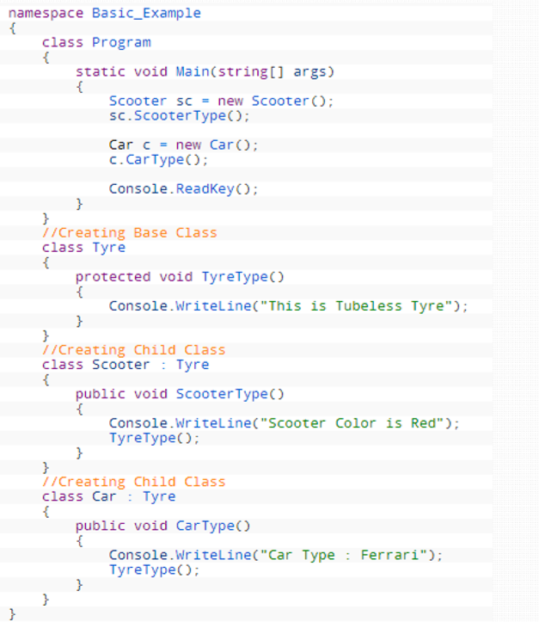
Example

Slide 12
Inheritance Task 01
Is it possible to access a private variable which declared inside base class from child class? Explain your answer.

Slide 13
Inheritance Task 02
Create a C# Console application.
Add two classes call ‘Faculty’ and ‘DegreeProgram’.
Make ‘DegreeProgram’ as the derived class (Child Class).
Inside ‘Faculty’ class create an integer variable call ‘student’ and assign value 100.
Inside the ‘DegreeProgram’ class create a void method call ‘Details’ and print the ‘student’ variable.
Call the method ‘Details’ inside main method via a class object.

Slide 14
Inheritance Task 03
Add a void method to ‘Faculty’ Class called ‘FacultyDetails’.
Inside the ‘FacultyDetails’ method print Hello.
Try to call the ‘FacultyDetails’ method by using the created class object.
Is it possible ? Explain your answer.

Slide 15


